Slide 1
MICROCONTROLLERS
Microcontroller (MCU)
Integrated electronic computing device that includes three major components on a single chip
Microprocessor (MPU)
Memory
I/O (Input/Output) ports
Embedded systems use microcontrollers

Slide 2
MICROPROCESSORS VS. MICROCONTROLLERS
MICROPROCESSOR | MICROCONTROLLER
CPU is stand-alone, RAM, ROM, I/O, timer are separate | CPU, RAM, ROM, I/O and timer are all on a single chip
designer can decide on the amount of ROM, RAM and I/O ports. | fixed amount of on-chip ROM, RAM, I/O ports
expensive | for applications in which cost, power and space are critical
versatility | single-purpose (control-oriented)
general-purpose | Low processing power
High processing power | Low power consumption
High power consumption | Bit-level operations
Instruction sets focus on processing-intensive operations | Instruction sets focus on control and bit level operations
Typically 32/64 – bit | Typically 8/16 bit
Typically deep pipeline (5-20 stages) | Typically single-cycle/two-stage pipeline

Slide 3
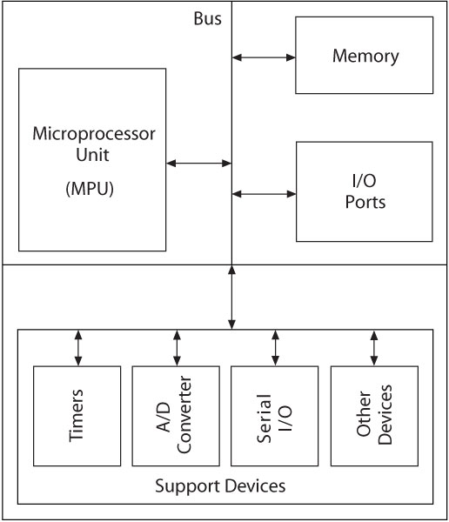
BLOCK DIAGRAM OF MICROCONTROLLER
Support Devices
Timers
A/D converter
Serial I/O
Common communication lines
System Bus

Slide 4
DIGITAL NUMBER SYSTEM
Microprocessors use binary number system
System | Base | Symbols
Decimal | 10 | 0, 1, … 9
Binary | 2 | 0, 1
Octal | 8 | 0, 1, … 7
Hexadecimal | 16 | 0, 1, … 9, A, B, … F

Slide 5
COMPUTER LANGUAGES
1ST generation language
binary (0 and 1) or machine level language
Microprocessor can understand only the binary codes
2ND generation language
Assembly level language
Symbols
Need to be converter to machine level language
3RD generation language
High level language
Use words and commands
C,C++,Java
4TH generation language- close to human language

Slide 6
COMPUTER LANGUAGES (cont.)
ASSEMBLER
ASSEMBLY LEVEL LANGUAGE
MACHINE LEVEL LANGUAGE
HIGH LEVEL LANGUAGE
COMPILER/ INTERPRETER
MACHINE LEVEL LANGUAGE

Slide 7
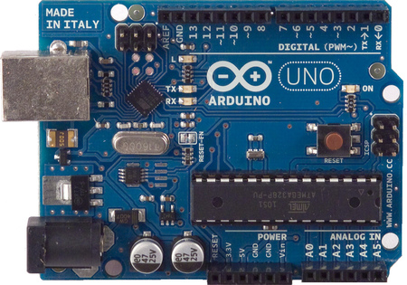
Arduino UNO

Slide 8
INTRODUCTION TO ARDUINO
A programmable micro controller for prototyping electromechanical devices
Can connect Digital and Analog electronic signals:
Sensors (Gyroscopes, GPS Locators, accelerometers)
Actuators (LEDS or electrical motors)

Slide 9
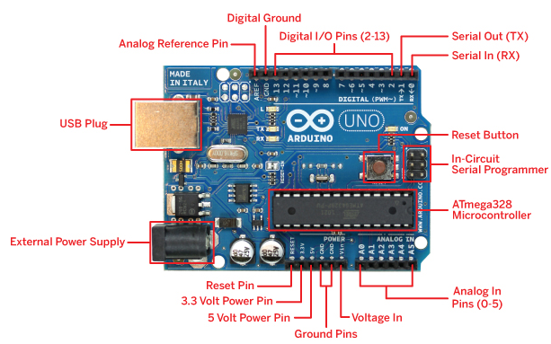
HARDWARE ARCHITECTURE

Slide 10
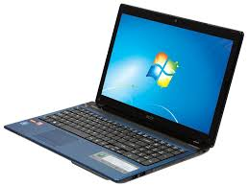
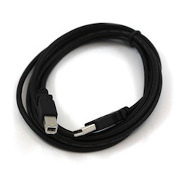
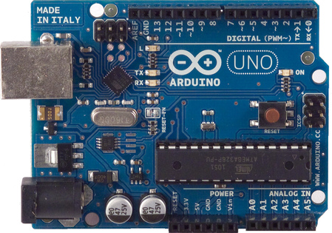
CONNECTION
USB A TO B

Slide 11
SPECIFICATIONS OF ARDUINO
Microcontroller | ATmega328P
Operating Voltage | 5V
Input Voltage (recommended) | 7-12V
Input Voltage (limit) | 6-20V
Digital I/O Pins | 14 (of which 6 provide PWM output)
PWM Digital I/O Pins | 6
Analog Input Pins | 6
DC Current per I/O Pin | 20 mA
DC Current for 3.3V Pin | 50 mA
Flash Memory | 32 KB (ATmega328P) of which 0.5 KB used by bootloader
SRAM | 2 KB (ATmega328P)
EEPROM | 1 KB (ATmega328P)
Clock Speed | 16 MHz
Length | 68.6 mm
Width | 53.4 mm
Weight | 25 g

